Slide 1
Compassion uk

Slide 2
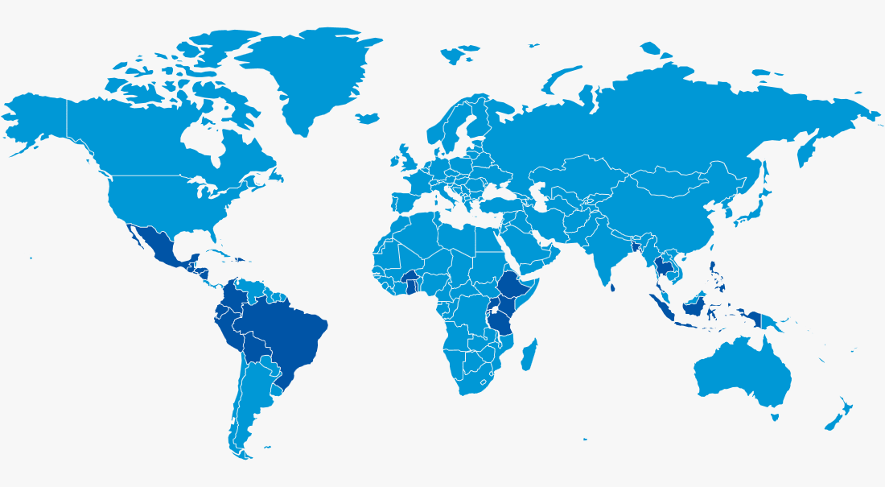
Which countries do they support?
They work in 25 countries across the world. Including Thailand, Kenya, Brazil and Mexico.

Slide 3
Education
Clean water
Watch the video to find out what Compassion UK do.
Doctors

Slide 4
Compassion uk

